Slide 1
Employee Performance Analysis using Python, SQL & Excel
HR Analytics Project
Name: Skanda Sai M

Slide 2
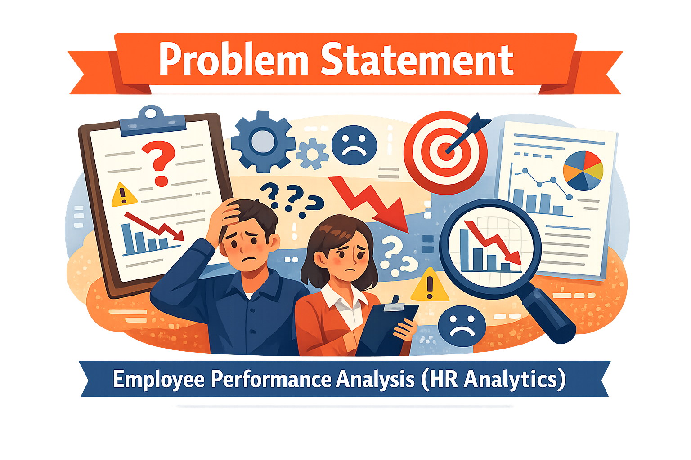
Problem Statement
The company faced difficulties in monitoring employee productivity and identifying factors affecting performance. HR teams needed a data-driven solution to analyze employee behavior, department efficiency, salary trends, and promotion patterns for better decision-making.

Slide 3
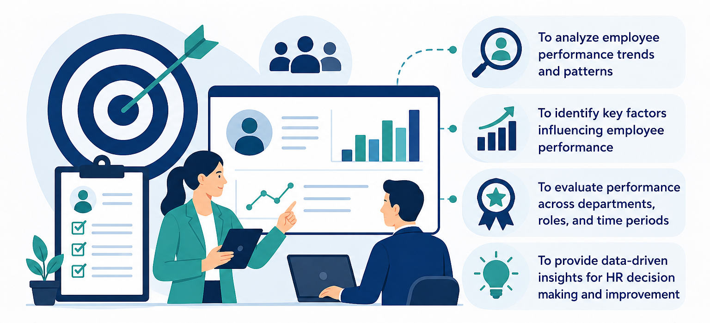
Objectives

Slide 4

Dataset Overview
Analysis Conducted on 1000 Employee Records
Columns Included
Employee ID
Department
Salary
Attendance
Projects Completed
Training Hours
Performance Score
Promotion Status

Slide 5
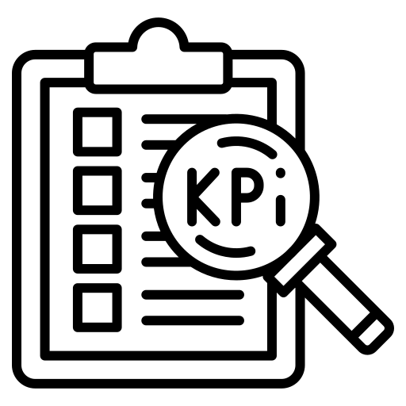
Key KPIs
Total Employees – Total number of employees included in the analysis
Average Salary – Average salary earned by employees across all departments
Best Performing Department – Department with the highest average performance score
Highest Performer – Employee with the highest performance score
Promotion Rate – Percentage of employees who received promotions

Slide 6
Exploratory Data Analysis (EDA)
Department Performance
Sales department had the highest performance score
IT department had the lowest performance score
Most departments showed similar performance levels
Overall employee performance was stable across departments

Slide 7
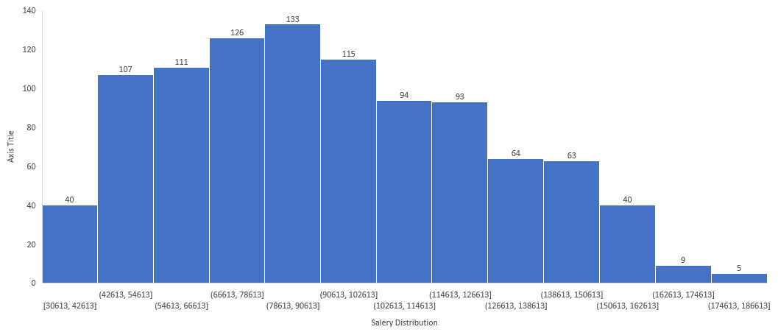
Salary Distribution
Most employees fall within the mid-range salary categories
Fewer employees receive very high salaries
Salary distribution is spread across different pay ranges in the organization

Slide 8
Promotion Rate
Majority of employees did not receive promotions
A smaller percentage of employees were promoted based on performance and experience
The chart highlights the overall promotion distribution in the organization

Slide 9
Gender Distribution
The organization has a balanced gender distribution
Female employees represent 52% of the workforce, while male employees account for 48%
The chart shows overall employee gender representation in the company

Slide 10
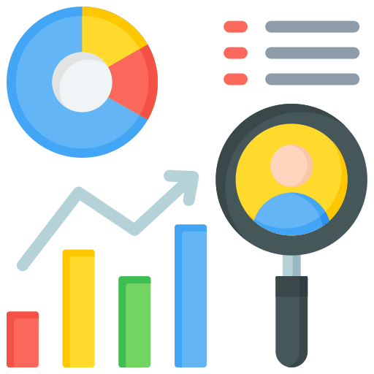
Key Insights
Operations department achieved highest performance
Attendance positively impacted productivity
Salary showed weak correlation with performance
Employees with higher training hours performed better

Slide 11

Conclusion
The project successfully analyzed employee performance trends using Python, SQL, and Excel. The analysis provided valuable HR insights that can help improve employee productivity, training strategies, and business decision-making.

